Slide 1
Removing a hard disk from a pc
HDD & SSD

Slide 2
How to remove a hard drive
Power Off & Unplug
Remove the Battery (If Removable)
Flip the laptop over
Unscrew and carefully remove the panel

Slide 3
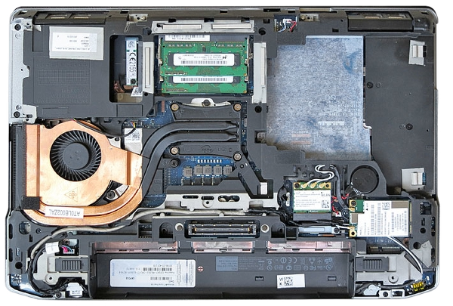

Slide 4
How to remove a hard drive (Continues…)
Locate the Hard Drive
Disconnect the Drive
Remove the Screws & Slide Out the Drive

Slide 5
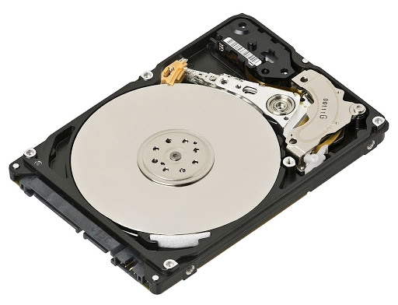

Slide 6
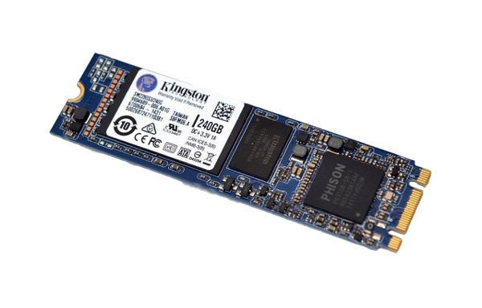

Slide 7
UP NEXT…
CREATING A FORENSIC IMAGE

